Slide 1


Slide 2


DEEP VEIN THROMBOSIS

Slide 3
Learning objectives
At the end of this activity , participants would be able to diagnose DVT
Feel more competent to treat DVT using various therapeutic options available
Have knowledge of various anticoagulants, both conventional and novel oral anticoagulants
Will know about various options for DVT prevention including dietary advices

Slide 4
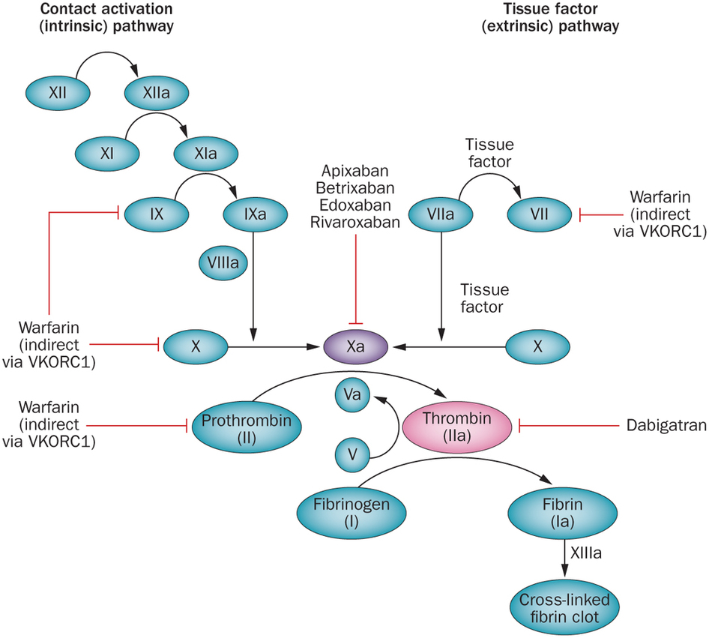

Slide 6
Definitions
Provoked DVT or PE: DVT or PE in patients with recent occurrence of major clinical risk factor for VTE
Unprovoked DVT or PE: DVT or PE in patients with no recently occurring major clinical risk factors for VTE or patients with active cancer, thrombophilia or family history of DVT (these are risks, but they are constant)
Proximal DVT: DVT in popliteal vein or above
Wells score: clinical prediction rules for estimating probability of DVT and PE
Notes:
NOTES FOR PRESENTERS:
The following terms are used in this guideline.
Provoked deep vein thrombosis (DVT) or pulmonary embolism (PE)
DVT or PE in a patient with an antecedent (within 3 months) and transient major clinical risk factor for VTE – for example surgery, trauma, significant immobility (bedbound, unable to walk unaided or likely to spend a substantial proportion of the day in bed or in a chair), pregnancy or puerperium – or in a patient who is having hormonal therapy (oral contraceptive or hormone replacement therapy).
Proximal DVT
DVT in the popliteal vein or above. Proximal DVT is sometimes referred to as ‘above-knee DVT’.
Renal impairment
Reduced renal function that may be acute or chronic. An estimated glomerular filtration rate of less than 90 ml/minute/1.73 m² indicates a degree of renal impairment in chronic kidney disease. (For NICE guidance on the classification of chronic kidney disease, see ‘Chronic kidney disease’ [NICE clinical guideline 73]).
Unprovoked DVT or PE
DVT or PE in a patient with:
no antecedent major clinical risk factor for VTE (see ‘Provoked deep vein thrombosis or pulmonary embolism’ above) who is not having hormonal therapy (oral contraceptive or hormone replacement therapy) or
active cancer, thrombophilia or a family history of VTE, because these are underlying risks that remain constant in the patient.
Wells scores
Clinical prediction rules for estimating the probability of DVT and PE. There are a number of versions of Wells scores available. This guideline recommends the two-level DVT Wells score and the two-level PE Wells score.

Slide 7
Venous thromboembolism
VTE is a serious health issue, mostly in hospitalized patients but also occurs spontaneously in non-hospitalized pts.
Most effective approach to decrease the burden of VTE is to prevent the development of DVT and PE in pts at high risk
Prompt diagnosis and treatment of DVT are essential to prevent PE which is a life threatening condition

Slide 8
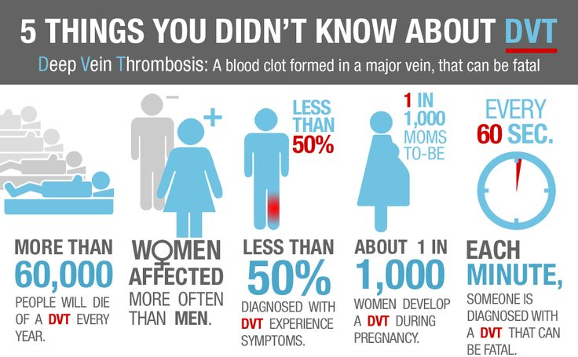

Slide 9
Studies from Pakistan
The prevalence of DVT in a cohort of pts with spinal cord injury following earth quake of 2005.
Prospective, observational study of 187 pts with acute spinal cord injury
Suspected DVT=17
Confirmed by U/S = 9 4.9%
Ref: spinal cord 2008 July.
In a review of DVT studies from Pakistan prevalence of DVT was found to be 2.6 -12.82%
Ref :J thrombos thrombolysis 2013 Feb;35(2)

Slide 10
Diagnosis of DVT
Objective testing for DVT is essential as clinical assessment alone is unreliable
Pre test probability
D-dimer
Doppler ultra sound
Venography
CT /MRI

Slide 11
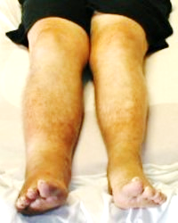
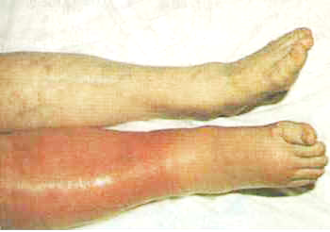
Deep vein thrombosis

Slide 12
inherited
acquired
Causes of thromboembolism

Slide 13
Inherited VE
Inherited thrombophilia
Factor V Leiden mutation
Prothrombin gene mutation
Protein S deficiency
Protein C deficiency
Antithrombin (AT) deficiency
Rare disorders
Dysfibrinogenemia

Slide 14
Other Plasma Factors
Plasma factor IX antigen
Plasma factor XI antigen
Thrombin activatable fibrinolysis inhibitor (TAFI)
Interleukin 8
Fibrinogen
Low levels of tissue factor pathway inhibitor
Low plasma fibrinolytic activity
Elevated plasma fibronectin levels

Slide 15
Acquired VE
Malignancy
Presence of a central venous catheter
Surgery, especially orthopedic
Trauma
Pregnancy
Oral contraceptives
Hormone replacement therapy

Slide 16
Acquired VE
Oral contraceptive pills that contain third-generation progestins are the most important cause of thrombosis in young women.
The risk of thrombosis increases within four months of the initiation of therapy and is unaffected by duration of use.
The risk decreases to previous levels within three months of cessation.
An increased risk for VTE has also been found in women using contraceptive transdermal patches and ring.

Slide 17
Acquired VE
Tamoxifen, Bevacizumab, Thalidomide, Lenalidomide
Immobilization
Congestive failure
Antiphospholipid antibody syndrome
Myeloproliferative disorders
Polycythemia vera
Essential thrombocythemia
Paroxysmal nocturnal hemoglobinuria

Slide 18
Acquired VE
Inflammatory bowel disease
Nephrotic syndrome
Hyperviscosity
Waldenstrom's macroglobulinemia
Multiple myeloma
Marked leukocytosis in acute leukemia
Sickle cell anemia
HIV/AIDS

Slide 19
Causes of Thromboembolism
In a population-based study of the incidence of venous thromboembolism (VTE), 56 percent of the patients had three or more of the following six risk factors present at the time of VTE:

Slide 20
Causes of Thromboembolism
>48 hours of immobility in the preceding month
Hospital admission
Surgery
Malignancy
Infection in the past three months
Current hospitalization

Slide 21
Pathophysiology
VIRCHOW'S TRIAD
Alterations in the constituents of the blood
Vascular endothelial injury
Alterations in blood flow (i.e., stasis)

Slide 22
DVT
There are a number of questions that arise when a patient is suspected of having deep vein thrombosis (DVT) of the lower extremity.

Slide 23
Differential Diagnosis?
Possible Risk Factors ?
The Best Way To Diagnose?

Slide 24
DVT
What is the appropriate initial therapy for DVT; when is hospitalization not required?
What is the recommended long-term treatment for DVT (e.g., agents to use, monitoring the degree of anticoagulation, length of time treatment is needed)?

Slide 25
DVT
When should one screen for the presence of a hypercoagulable state, not only in the patient, but also in family members?

Slide 26
DVT
INITIAL APPROACH
When approaching the patient with suspected DVT of the lower extremity, it is important to appreciate that only a minority of patients actually have the disease and will require anticoagulation.

Slide 27
DVT
Risk Of Treating
Bleeding
Allergy
Risk Of Not Treating
Dvt
PE
Stroke
This illustrates the importance of using validated algorithms to evaluate patients with suspected DVT, along with objective testing to establish the diagnosis.

Slide 28
DVT History
Classic symptoms of DVT include swelling, pain, and discoloration in the involved extremity.
There is not necessarily a correlation between the location of symptoms and the site of thrombosis.

Slide 29
DVT History
Recent potential precipitating conditions
Underlying conditions: i.e. cancer, collagen-vascular disorders
Medications

Slide 30
DVT Physical Exam
Special attention should be directed to:
The vascular system
Extremities (e.g., looking for signs of superficial or deep vein thrombosis)
Chest
Heart
Abdominal organs
Skin (e.g., skin necrosis, livedo reticularis).

Slide 31
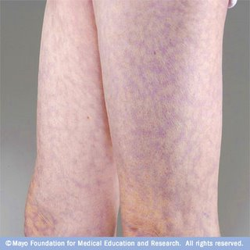

Slide 32
DVT Physical Exam
There may be pain and tenderness in the thigh along the course of the major veins ("painful deep vein syndrome").
Tenderness on deep palpation of the calf muscles is suggestive, but not diagnostic.
Homan's sign is unreliable.

Slide 33
DVT Physical Exam
A 2005 meta-analysis of diagnostic cohort studies of patients with suspected DVT concluded the following concerning these physical findings:
Only a difference in calf diameters (likelihood ratio, LR 1.8; 95% CI 1.5-2.2) was of potential value for ruling in DVT.

Slide 34
DVT Physical Exam
Homan’s sign
Discomfort in the calf muscles on forced dorsiflexion of the foot with the knee straight has been a time-honored sign of DVT.
However, this sign is present in less than one third of patients with confirmed DVT.
The Homan’s sign is found in more than 50% of patients without DVT and, therefore, is nonspecific.

Slide 35
DVT Physical Exam
-Tenderness occurs in 75% of patients but is also found in 50% of patients without objectively confirmed DVT.
-The pain and tenderness associated with DVT does not usually correlate with the size, location, or extent of the thrombus.
-Warmth or erythema of skin can be present over the area of thrombosis

Slide 36
DVT Physical Exam
Superficial thrombophlebitis is characterized by the finding of a palpable, indurated, cordlike, tender, subcutaneous venous segment.
Forty percent of patients with superficial thrombophlebitis without coexisting varicose veins and with no other obvious etiology (e.g., intravenous catheters, intravenous drug abuse, soft tissue injury) have an associated DVT.

Slide 37
DVT Differential Diagnosis
Lymphangitis or lymph obstruction | 7 percent
Baker's cyst | 5 percent
Cellulitis | 3 percent
Knee abnormality | 2 percent
Venous insufficiency (reflux) | 7 percent
Unknown | 26 percent

Slide 38
DVT Diagnosis
The clinical assessment of patients with suspected DVT is often difficult because of the interplay between risk factors and the nonspecific nature of the physical findings.
Clinicians have observed that a discordance is often present between the clinical assessment and the results of objective testing.

Slide 39
DVT Diagnosis
The Wells clinical prediction guide quantifies the pretest probability of DVT.
The model enables providers to reliably stratify their patients into high-, moderate-, or low-risk categories.
Combining this with the results of objective testing greatly simplifies the clinical workup of patients with suspected DVT.
The Wells clinical prediction guide incorporates risk factors, clinical signs, and the presence or absence of alternative diagnoses.

Slide 40
DVT Diagnosis
For example, patients deemed to be at high risk for DVT may have a negative finding on duplex ultrasonographic study.
In this case, the probability of DVT is still greater than 20% when the known sensitivity, specificity, and negative likelihood ratio of duplex ultrasonography are considered.
Having an objective method to determine pretest probability simplifies clinical management.

Slide 41
Clinical Parameter Score
Score
Active cancer (treatment ongoing, or within 6 mo or palliative)
+1
Paralysis or recent plaster immobilization of the lower extremities
+1
Recently bedridden for >3 d or major surgery <4 wk
+1
Localized tenderness along the distribution of the deep venous system
+1
Entire leg swelling
+1
Calf swelling >3 cm compared with the asymptomatic leg
+1
Pitting edema (greater in the symptomatic leg)
+1
Previous DVT documented
+1
Collateral superficial veins (nonvaricose)
+1
Alternative diagnosis (as likely or greater than that of DVT)
-2
(e.g., Baker's cyst, cellulitis, muscle damage, post phlebitic syndrome, inguinal lymphadenopathy, external venous compression (-2 points)
Total of Above Score
High probability
>3
Moderate probability
1 or 2
Low probability
<0

Slide 42
Reference for Modified Wells Score
Adapted from JAMA. 1998 Apr 8;279(14):1094-9.
Value of assessment of pretest probability of deep-vein thrombosis in clinical management. Wells PS; Anderson DR; Bormanis J; Guy F; Mitchell M; Gray L; Clement C; Robinson KS; Lewandowski B. Lancet 1997 Dec 20-27;350(9094):1795-8.

Slide 43
Well’s DVT criteria
This criteria can be used in opd /ER to stratify risk of having DVT
If well score is <2 and D-Dimer is negative, then U/S is not required
This score is not useful for hospitalized pts

Slide 44
DVT D-dimer
Recent interest has focused on the use of D-dimer in the diagnostic approach to DVT.
D-dimer fibrin fragments are present in fresh fibrin clot and in fibrin degradation products of cross-linked fibrin.
These specific attributes of the D-dimer antibodies account for their high sensitivity for venous thromboembolism.

Slide 45
DVT D-dimer
D-dimer level may be elevated in any medical condition where clots form.
Many of these conditions are associated with higher risk for DVT.
The D-dimer assays have low specificity for DVT; therefore, they should only be used to rule out DVT, not to confirm the diagnosis of DVT.

Slide 46
Medical Conditions Associated With an Elevated D-dimer
Arterial thromboembolic disease
Myocardial infarction
Stroke
Acute limb ischemia
Atrial fibrillation
Intracardiac thrombus

Slide 47
Medical Conditions Associated With an Elevated D-dimer
Venous thromboembolic disease
Deep vein thrombosis
Pulmonary embolism
Disseminated intravascular coagulation
Preeclampsia and eclampsia
Abnormal fibrinolysis; use of thrombolytic agents

Slide 48
Medical Conditions Associated With an Elevated D-dimer
Systemic inflammatory response syndrome
Vasoocclusive episode of sickle cell disease
Severe liver disease (decreased clearance)
Malignancy

Slide 49
Medical Conditions Associated With an Elevated D-dimer
Renal disease
Nephrotic syndrome (e.g., renal vein thrombosis)
Acute renal failure
Chronic renal failure and underlying cardiovascular disease
Normal pregnancy
Venous malformations

Slide 50
DVT D-dimer
D-dimer levels remain elevated in DVT for about 7 days.
Patients presenting late in the course, after clot organization and adherence have occurred, may have low levels of D-dimer.
Similarly, patients with isolated calf vein DVT may have a small clot burden and low levels of D-dimer that are below the analytic cut-off value of the assay.
This accounts for the reduced sensitivity of the D-dimer assay in the setting of confirmed DVT.

Slide 51
DVT D-dimer
D-dimer results should be used as follows:
A negative D-dimer assay result rules out DVT in patients with low-to-moderate risk and a Wells DVT score less than 2.
All patients with a positive D-dimer assay result and all patients with a moderate-to-high risk of DVT (Wells DVT score >2) require a diagnostic study (duplex ultrasonography).

Slide 52
DVT D-dimer
A D-dimer level less than 200 to 500 ng/mL by ELISA or a negative SimpliRED assay in conjunction with a low clinical probability of DVT appears to be useful and cost- effective in excluding DVT without the need for an ultrasound examination.

Slide 53
Diagnosis of DVT
In most circumstances, compression ultrasonography is the noninvasive approach of choice for the diagnosis of patients with suspected DVT.
If unavailable, impedance plethysmography with serial studies is an acceptable alternative.
One exception noted above is that impedance plethysmography is preferred for possible recurrent DVT since it normalizes more quickly after a previous episode than compression ultrasonography.

Slide 54
Compression Ultrasonography
The diagnosis of venous thrombosis using compression ultrasonography is made by the findings such as:
Abnormal compressibility of the vein
Abnormal Doppler color flow
The presence of an echogenic band
Abnormal change in diameter during the Valsalva maneuver

Slide 55
Compression Ultrasonography
Color flow imaging, in addition to duplex Doppler ultrasound, is a less demanding study and is also highly accurate for the diagnosis of above the knee DVT.

Slide 56
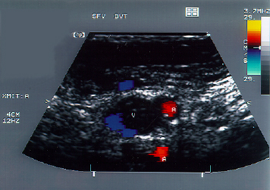
Duplex-Doppler ultrasound image of an acute superficial femoral vein thrombosis (labeled "V")
Blue color indicates venous blood flow and red indicates arterial blood flow (labeled "A"). Echogenic white speckles are seen in the vein which was non-compressible with the ultrasound probe.

Slide 57
Compression Ultrasonography
Duplex ultrasonography is also helpful to differentiate venous thrombosis from hematoma, Baker cyst, abscess, and other causes of leg pain and edema.
Diagnostic accuracy varies depending on local expertise.

Slide 58
MRI
MRI is the diagnostic test of choice for suspected iliac vein or inferior vena caval thrombosis when CT venography is contraindicated or technically inadequate.
In the second and third trimester of pregnancy, MRI is more accurate than duplex ultrasonography because the gravid uterus alters Doppler venous flow characteristics.
Expense, lack of general availability, and technical issues limit its use.

Slide 59
Screening For A Hypercoaguable State
A biologic risk factor for venous thrombosis can be identified in over 60 percent of Caucasian patients with idiopathic DVT. In addition, there is often more than one factor at play in a given patient.
As an example, 50 percent of thrombotic events in patients with inherited thrombophilia are associated with an accompanying acquired risk factor (e.g., surgery, pregnancy, use of oral contraceptives).

Slide 60
Screening For A Hypercoaguable State
There is currently no consensus regarding whom to test for inherited thrombophilia.
The likelihood of identifying an inherited thrombophilia is increased several-fold by screening only patients with one or more of the following:

Slide 61
Recurrent VTE
unusual vascular beds. portal, hepatic, mesenteric, or cerebral veins
A history of warfarin-induced skin necrosis(protein C deficiency)
VTE prior to age 50 with no immediately identified risk factor
A family history of VTE

Slide 62
Even if a hypercoagulable workup uncovers abnormalities predisposing to VTE, the strongest risk factor for VTE recurrence is the prior VTE event itself, particularly if idiopathic.
Screening For A Hypercoaguable State

Slide 63
Screening information can be used to identify family members with an inherited thrombophilia, but anticoagulant prophylaxis is rarely recommended in asymptomatic affected family members outside of high risk situations.
Screening For A Hypercoaguable State

Slide 64
Goals of therapy in DVT/PE
Prevention of thrombus growth
Symptomatic relief
Prevention of recurrence of DVT/PE

Slide 65
Treatment of DVT
Medical Therapy
IVC Filter
Thrombolysis
Thrombectomy

Slide 66
Treatment of DVT
The use of thrombolytic agents, surgical thrombectomy, or percutaneous mechanical thrombectomy in the treatment of venous thromboembolism must be individualized.
Patients with hemodynamically unstable PE or massive iliofemoral thrombosis (i.e., phlegmasia cerulea dolens), and who are also at low risk to bleed, are the most appropriate candidates for such treatment.

Slide 67
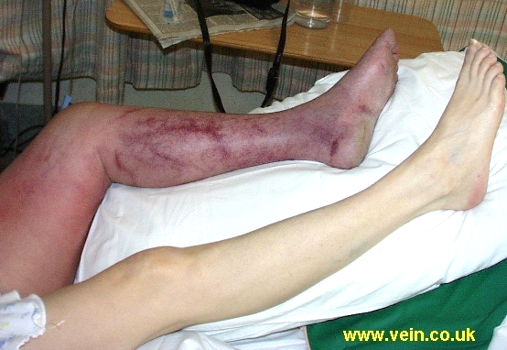

Slide 68
Treatment of DVT
Inferior vena caval filter placement is recommended when there is a contraindication to, or a failure of, anticoagulant therapy in an individual with, or at high risk for, proximal vein thrombosis or PE.
It is also recommended in patients with recurrent thromboembolism despite adequate anticoagulation, for chronic recurrent embolism with pulmonary hypertension, and with the concurrent performance of surgical pulmonary embolectomy or pulmonary thromboendarterectomy.

Slide 69
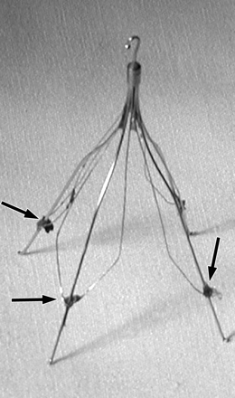

Slide 70
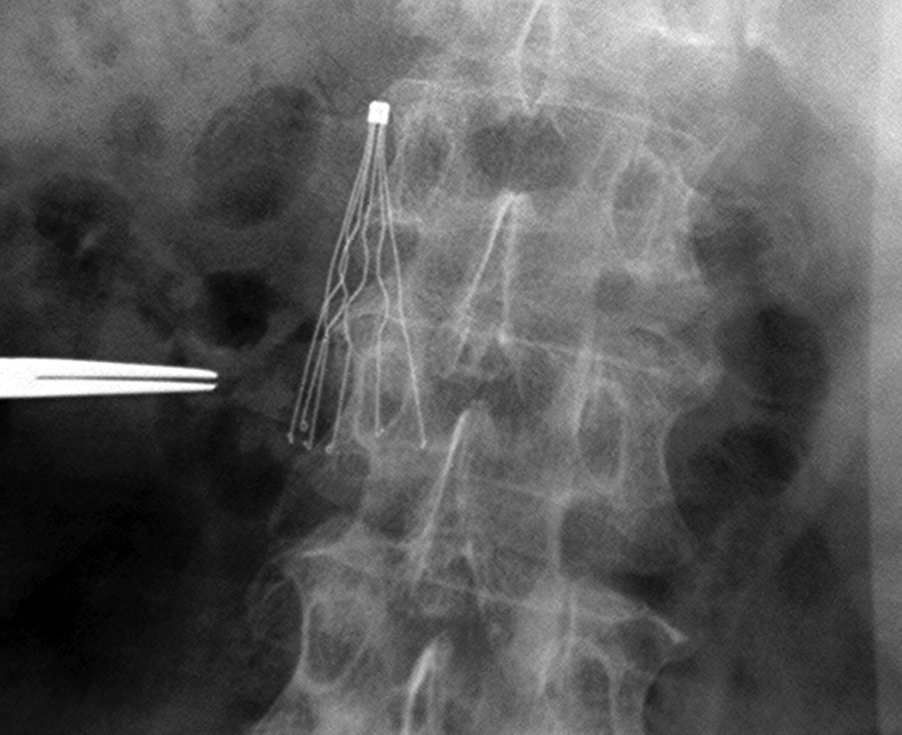

Slide 71
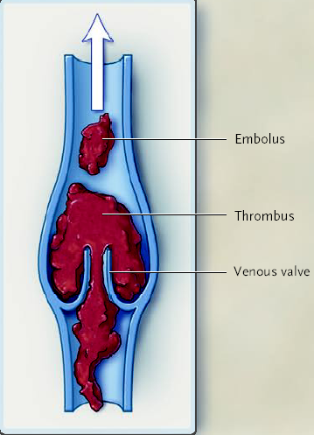

Slide 72
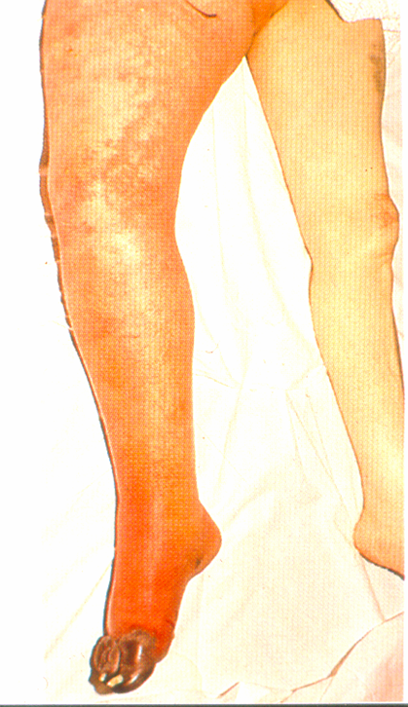
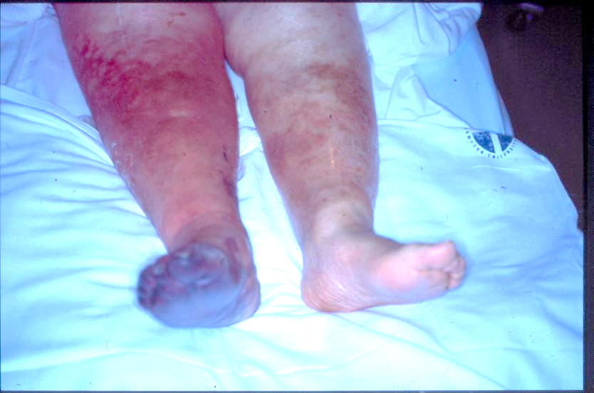
PHLEGMASIA CERULEA DOLENS-Venous gangrene (painful blue edema)

Slide 73
Types of anticoagulants
Anticoagulants are classified mainly as
  Conventional &
  Novel
Another way to classify is:
  Parenteral &
  Oral

Slide 74
Conventional
Heparin: used parentrally
VKA: warfarin used orally

Slide 75
Novel
Direct thrombin inhibitor:
    Dabigatran
Factor Xa inhibitors:
  Rivaroxaban.
  Apixaban

Slide 76
Heparin: types
Unfractionated Heparin (UFH)
Low molecular weight heparin (LMWH)
  Enoxaparin
  Dalteparin
  Tinzaparin

Slide 77
Treatment of DVT/PE with anti coagulation
Traditionally treatment of DVT/PE is started with parenteral agents then overlapping with VKA for long term and extended use
As VKA have a delayed onset of action, the transition requires close monitoring of INR, with parenteral anticoagulation continued for a minimum of 5 days and until INR is between 2-3 for at least 24 hour
Frequent monitoring and dose adjustment is required throughout the treatment with VKA in order to maintain desired INR(2.0-3.0)

Slide 78
Parenteral therapy
LMWH is the treatment of choice for most patients
Although Fondaparinux ( ARIXTRA) and UFH can also be used
LMWH,UFH and Fondaparinux are given by S/C injection
UFH can also be given i/v

Slide 79
HIT
Heparin induced thrombocytopenia is immunohematologic mediated syndrome characterized by thrombocytopenia
Develops after 5 to 10 days of treatment
It can be complicated by venous or arterial thrombosis.
Incidence of HIT is 1-3% with UFH

Slide 80
HIT: Etiology
HIT is caused by IgG antibody, HIT –IgG that is directed against complex of heparin and platelet factor 4, on the platelet surface.
The resulting immune complex interacts with platelet Fc receptor leading to potent platelet activation.
LMWH is less likely to cause HIT than UF

Slide 81
HIT: D/D
Fever with chills, sepsis
Recent surgery, dilutional b/c I/V fluids
Blood transfusions leading to hemodilution
DIC and multiorgan failure
Acute abdominal pain and hypotension , acute adrenal failure due to bilateral adrenal hemorrhagic infarction in 1-2% HIT pts
Painful plaques or frank necrosis at the site of heparin inj 5-7 days after hospitalization can indicate HIT in 10-20% pts of HIT

Slide 82
HIT: Diagnosis
Diagnostic lab tests are not widely available
Diagnosis of HIT is usually clinical
Also needed are tests to exclude other causes of thrombocytopenia eg blood c/s ,peripheral film, tests for DIC and drugs
Most HIT pts have increased levels of D-dimers

Slide 83
HIT: Complications
Arterial and venous thrombosis can occur any where in the body
Stroke, MI, limb ischemia, mesenteric ischemia, DVT and PE can occur with HIT
Keep high index of suspicion for thrombosis in HIT

Slide 84
HIT: Treatment
Stop heparin immediately
Direct factor Xa inhibitor eg Danaparoid or direct thrombin inhibitor Argatroban / Lepirudin can be used to treat HIT
LMWH is not recommended in treatment of HIT
Danaparoid is a LMW heprinoid.

Slide 85
Warfarin: Indications
Deep vein thrombosis
Pulmonary embolism
Stroke prevention in Atrial fibrillation
Prosthetic mechanical heart valves to prevent emboli
3 wks before and 4 wks after cardio version

Slide 86
Novel Anticoagulats
Also called NOACS: these are Non-vitamin K oral anticoagulants, this group includes:
  Dabigatran (Pradaxa)
  Apixaban (Eliquis)
  Rivaroxaban (xcept)
  Edoxaban (Savaysa)

Slide 87
Rivaroxaban (Xcept)
It is a direct inhibitor of factor Xa
Available as tab. Xcept 10 mg,15mg and 20 mg
FDA approval for 6 indications
Approved for stroke prevention in non valvular AF
Also approved for prevention and treatment of DVT and Pulmonary embolism
Prevention of DVT in knee and hip replacement
NOT approved for ACS in USA

Slide 88
Current indications for which rivaroxaban is approved for use in clinical practice in the EU
Indication | Dose and regimen | Duration of therapy | Patient population
Prevention of VTE in adult patients undergoing elective hip replacement surgery | 10 mg od | 5 weeks of anticoagulation is recommended | Adults aged ≥18 years undergoing elective hip replacement surgery
Prevention VTE in adult patients undergoing elective knee replacement surgery | 10 mg od | 2 weeks of anticoagulation is recommended | Adults aged ≥ 18 years undergoing elective knee replacement surgery
Treatment of DVT, PE and prevention of recurrent DVT and PE in adults | 15 mg bid for first 3 weeks followed by 20 mg od A reduction of the dose from 20 mg once daily to 15 mg once daily should be considered if the patient’s assessed risk for bleeding outweighs the risk for recurrent DVT and PE | Based on transient risk factors such as recent surgery, trauma, immobilisation: short duration of therapy (3 months) is recommended Based on permanent risk factors or idiopathic DVT/PE: longer duration therapy recommended | Adults with DVT, PE or at risk of recurrent DVT and PE
Prevention of stroke and systemic embolism in adult patients with non-valvular AF with ≥1 risk factors, e.g. CHF, Hypertension, Age ≥ 75 years, Diabetes mellitus, Prior stroke or TIA | 20 mg od (15 mg od for patients with moderate or severe renal impairment*) | Clinical judgement applies: Recommended for long term use, if the benefit of prevention of stroke and systemic embolism outweighs risk of bleeding | In adult patients with non-valvular atrial fibrillation with CHADS₂ Score ≥ 1
*moderate renal impairment = CrCl: 30‑49 ml/miin, severe renal impairment = CrCl: 15 ‑ 29 ml/min
Ref: Summary of Product Characteristics. http://www.xarelto.com/html/downloads/Xarelto-Prescribing_Information-Nov-2012.pdf

Slide 89
risk of bleeding
  Like all anticoagulants, Rivaroxaban may increase the risk of bleeding
  Certain patient populations are at higher risk
      Patients with renal impairment
      Patients with hepatic impairment
      Patients concomitantly receiving certain other medicinal products
      Patients with other hemorrhagic risk factors
  Treatment decision in these patients should be done after assessment of treatment benefit against the risk for bleeding

Slide 90
Catheter directed thrombolysis
In pts with acute proximal DVT of the leg, anticoagulant therapy alone is suggested over CDT

Slide 91
Risk factors for bleeding with anticoagulation therapy

Slide 92
Rivaroxaban 15 mg, PO, BID x 3 weeks then 20mg, Qday
Enoxaparin 1mg/kg/Q12hrs bridge to Warfarin INR 2-3
Open Label, Non-Inferiority trial
Einstein Investigators NEJM 2010;363:2499-2510

Slide 93
Einstein DVT
Rivaroxaban
15 mg, BID x 3 wks
20 mg, Qday
VTE Major Bld
2.1% 8.1%
DVT
Enoxaparin
Warfarin INR 2-3
3.0% 8.1%
3, 6, 12 months
Proximal DVT
Einstein Investigators NEJM 2010;363:2499-2510

Slide 94
Einstein Acute DVT Study
Acute DVT Study
INR = 57.7% TTR
3.0%
2.1%
TTR = Therapeutic Time in Range
Einstein Investigators NEJM 2010;363:2499-2510

Slide 95
Einstein Acute DVT Study
Causes of VTE
Riva
Standard
Einstein Investigators NEJM 2010;363:2499-2510

Slide 96
Einstein Acute DVT Study
8.1%
8.1%
HR = 0.97 (95% CI, 0.76 to 1.22, P=0.77)
Einstein Investigators NEJM 2010;363:2499-2510

Slide 97
Einstein Acute DVT Study
Safety Outcomes
Riva
Standard
Einstein Investigators NEJM 2010;363:2499-2510

Slide 98
Rivaroxaban 15 mg, PO, BID x 3 weeks then 20mg, Qday
Enoxaparin 1mg/kg/Q12hrs bridge to Warfarin INR 2-3
Open Label, Non-Inferiority
Einstein Investigators NEJM 2012;366:1287-1297

Slide 99
Einstein PE
Rivaroxaban
15 mg, BID x 3 wks
20 mg, Qday
VTE Major Bld
2.1% 1.1%
PE
Enoxaparin
Warfarin INR 2-3
Non-Inferior
1.8% 2.2%
3, 6, 12 months
Warfarin TTR = 62.7%
Einstein-PE Investigators NEJM 2012;366:1287-1297

Slide 100
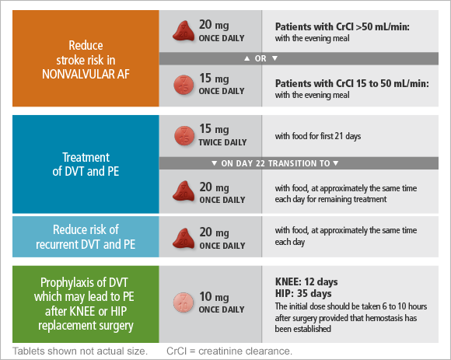

Slide 101
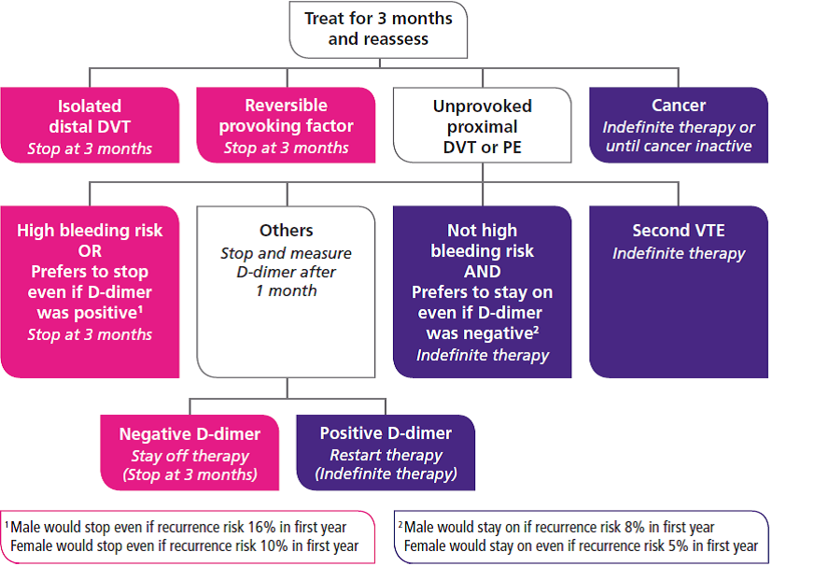

Slide 102
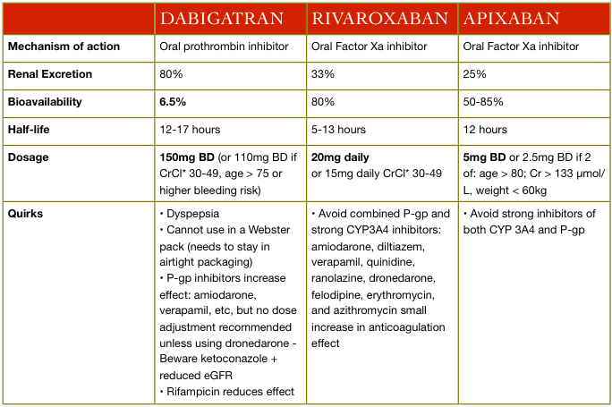

Slide 103
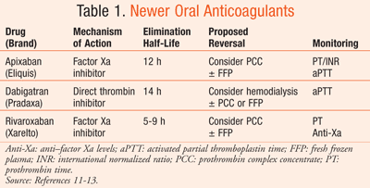

Slide 104
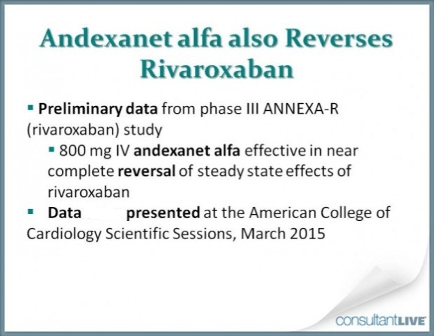

Slide 105
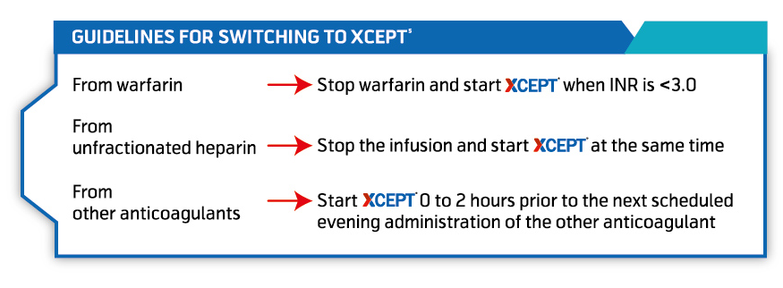

Slide 106
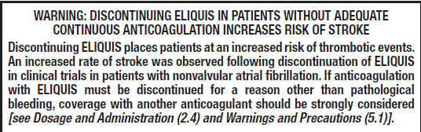
Black Box Warning
Rivaroxaban & Apixaban

Slide 107


